Slide 1





Defining Classes – Part II
REMEBER TO ADD A SECTION ON RECORDS (NEW IN c# 9)
Static Members, Structures, Enumerations, Generic Classes, Namespaces
Telerik Software Academy
Object-Oriented
academy.telerik.com

Slide 2
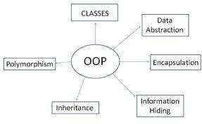

Table of Contents
Static Members
Structures in C#
Generics
Namespaces
Indexers
Operators
Attributes

Slide 3

Static Members
Static vs. Instance Members

Slide 4

Static Members
Static members are associated with a type rather than with an instance
Defined with the modifier static
Static can be used for
Fields
Properties
Methods
Events
Constructors

Slide 5
Static vs. Non-Static
Static:
Associated with a type, not with an instance
Non-Static:
The opposite, associated with an instance
Static:
Initialized just before the type is used for the first time
Non-Static:
Initialized when the constructor is called

Slide 6

Static Members – Example
static class SqrtPrecalculated
{
public const int MAX_VALUE = 10000;
// Static field
private static int[] sqrtValues;
// Static constructor
static SqrtPrecalculated()
{
sqrtValues = new int[MAX_VALUE + 1];
for (int i = 0; i < sqrtValues.Length; i++)
{
sqrtValues[i] = (int)Math.Sqrt(i);
}
}
(example continues)

Slide 7

Static Members – Example (2)
// Static method
public static int GetSqrt(int value)
{
return sqrtValues[value];
}
}
class SqrtTest
{
static void Main()
{
Console.WriteLine(
SqrtPrecalculated.GetSqrt(254));
// Result: 15
}
}

Slide 8

Static Members
Live Demo

Slide 9
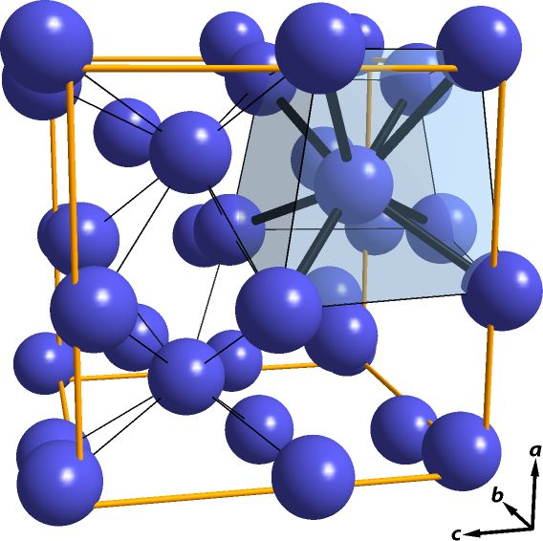
C# Structures

Slide 10
C# Structures
What is a structure in C#?
A value data type (behaves like a primitive type)
Examples of structures: int, double, DateTime
Classes are reference types
Declared by the keyword struct
Structures, like classes, have properties, methods, fields, constructors, events, …
Always have a parameterless constructor
It cannot be removed
Mostly used to store data (bunch of fields)

Slide 11
C# Structures – Example
struct Point
{
public int X { get; set; }
public int Y { get; set; }
}
struct Color
{
public byte RedValue { get; set; }
public byte GreenValue { get; set; }
public byte BlueValue { get; set; }
}
enum Edges { Straight, Rounded }
(example continues)

Slide 12
C# Structures – Example (2)
struct Square
{
public Point Location { get; set; }
public int Size { get; set; }
public Color SurfaceColor { get; set; }
public Color BorderColor { get; set; }
public Edges Edges { get; set; }
public Square(Point location, int size,
Color surfaceColor, Color borderColor,
Edges edges) : this()
{
this.Location = location;
this.Size = size;
this.SurfaceColor = surfaceColor;
this.BorderColor = borderColor;
this.Edges = edges;
}
}

Slide 13
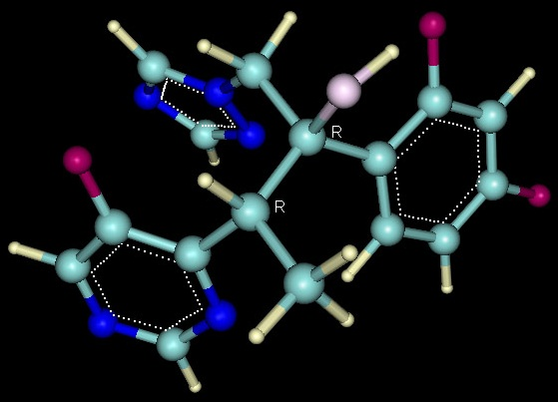

C# Structures
Live Demo

Slide 14

Generic Classes
Parameterizing Classes

Slide 15
What are Generics?
Generics allow defining parameterized classes that process data of unknown (generic) type
The class can be instantiated (specialized) with different particular types
Example: List<T> → List<int> / List<string> / List<Student>
Generics are also known as "parameterized types" or "template types"
Similar to the templates in C++
Similar to the generics in Java

Slide 16
Generics – Example
T is an unknown type, parameter of the class
public class GenericList<T>
{
public void Add(T element) { … }
}
class GenericListExample
{
static void Main()
{
// Declare a list of type int
GenericList<int> intList =
new GenericList<int>();
// Declare a list of type string
GenericList<string> stringList =
new GenericList<string>();
}
}
T can be used in any method in the class
T can be replaced with int during the instantiation

Slide 17
The ”official” guide
Microsoft’s C# Programming Guide
https://docs.microsoft.com/en-us/dotnet/csharp/programming-guide/generics/
Generics in .NET
https://docs.microsoft.com/en-us/dotnet/standard/generics/

Slide 18
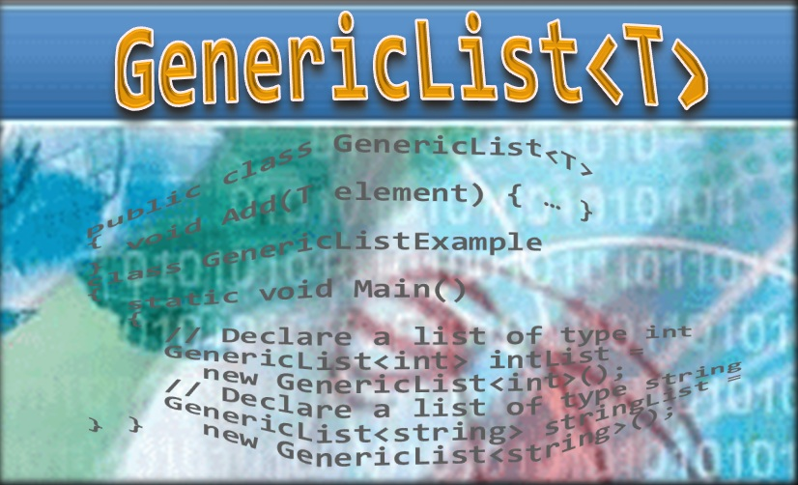
Generic Classes
Live Demo

Slide 19
Defining Generic Classes
Generic class declaration:
Example:
class MyClass <type-parameter-list> : class-base
where <type-parameter-constraints-clauses>
{
// Class body
}
class MyClass<T> : BaseClass
where T : new()
{
// Class body
}

Slide 20
Generic Constraints Syntax
Parameter constraints clause:
Example:
public SomeGenericClass<some parameters>
where type-parameter : primary-constraint,
secondary-constraints,
constructor-constraint
public class MyClass<T>
where T: class, IEnumerable<T>, new()
{…}

Slide 21
Generic Constraints
Primary constraint:
class (reference type parameters)
struct (value type parameters)
Secondary constraints:
Interface derivation
Base class derivation
Constructor constraint:
new() – parameterless constructor constraint

Slide 22
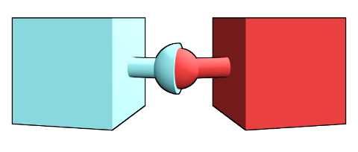
Generic Constraints
Live Demo

Slide 23
Generic Method – Example
public static T Min<T>(T first, T second)
where T : IComparable<T>
{
if (first.CompareTo(second) <= 0)
return first;
else
return second;
}
static void Main()
{
int i = 5;
int j = 7;
int min = Min<int>(i, j);
}

Slide 24

Generic Methods
Live Demo

Slide 25
More reading
Constraints in Generics at TutorialsTeacher
https://www.tutorialsteacher.com/csharp/constraints-in-generic-csharp

Slide 26


Namespaces

Slide 27
Namespaces
Namespaces logically group type definitions
May contain classes, structures, interfaces, enumerators and other types and namespaces
Can not contain methods and data directly
Can be allocated in one or several files
Namespaces in .NET are similar to namespaces in C++ and packages in Java
Allows definition of types with duplicated names
E.g. a type named Button is found in Windows Forms, in WPF and in ASP.NET Web Forms

Slide 28
Including Namespaces
Including a namespace
The using directive is put at the start of the file
using allows direct use of all types in the namespace
Including is applied to the current file
When including a namespace with using its subset of namespaces is not included
using System.Windows.Forms;

Slide 29
Including Namespaces (2)
Types, placed in namespaces, can be used and without using directive, by their full name:
using can create allies for namespaces :
System.IO.StreamReader reader =
System.IO.File.OpenText("file.txt");
using IO = System.IO;
using WinForms = System.Windows.Forms;
IO.StreamReader reader =
IO.File.OpenText("file.txt");
WinForms.Form form = new WinForms.Form();

Slide 30
Defining Namespaces
Divide the types in your applications into namespaces
When the types are too much (more than 15-20)
Group the types logically in namespaces according to their purpose
Use nested namespaces when the types are too much
E.g. for Tetris game you may have the following namespaces: Tetris.Core, Tetris.Web, Tetris.Win8, Tetris.HTML5Client

Slide 31
Defining Namespaces (2)
Distribute all public types in files identical with their names
E.g. the class Student should be in the file Student.cs
Arrange the files in directories, corresponding to their namespaces
The directory structure from your project course-code must reflect the structure of the defined namespaces

Slide 32
Namespaces – Example
namespace SofiaUniversity.Data
{
public struct Faculty
{
// …
}
public class Student
{
// …
}
public class Professor
{
// …
}
public enum Specialty
{
// …
}
}

Slide 33
Namespaces – Example (2)
namespace SofiaUniversity.UI
{
public class StudentAdminForm : System.Windows.Forms.Form
{
// …
}
public class ProfessorAdminForm : System.Windows.Forms.Form
{
// …
}
}
namespace SofiaUniversity
{
public class AdministrationSystem
{
public static void Main()
{
// …
}
}
}

Slide 34
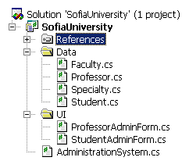
Namespaces – Example (3)
Recommended directory structure and classes organization in them

Slide 35

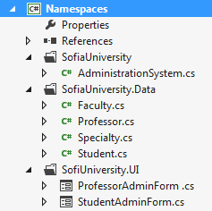
Namespaces
Live Demo

Slide 36

Indexers
public int this [int index]
{
…
}
var value = list[5];

Slide 37
Indexers
Indexers provide indexed access class data
Predefine the [] operator for certain type
Like when accessing array elements
Can accept one or multiple parameters
Defining an indexer:
IndexedType t = new IndexedType(50);
int i = t[5];
t[0] = 42;
personInfo["Svetlin Nakov", 28]
public int this [int index] { … }

Slide 38
Indexers – Example
class TempRecord
{
// Array of temperature values
private float[] temps = new float[5] { 56.2F, 56.7F, 56.5F, 56.9F, 58.8 };
// To enable client code to validate input
// when accessing your indexer.
public int Length
{
get { return temps.Length; }
}
(the example continues)

Slide 39
Indexers – Example (2)
// Indexer declaration.
// If index is out of range, the temps array will throw the exception.
public float this[int index]
{
get
{
return temps[index];
}
set
{
temps[index] = value;
}
}
} (the example continues)

Slide 40
Indexers – Example (3)
class MainClass
{
static void Main()
{
TempRecord tempRecord = new TempRecord();
// Use the indexer's set accessor
tempRecord[2] = 58.3F;
tempRecord[4] = 60.1F;
// Use the indexer's get accessor
for (int i = 0; i < 5; i++)
{
System.Console.WriteLine("Element #{0} = {1}", i, tempRecord[i]);
}
}
}
Element #0 = 56.2
Element #1 = 56.7
Element #2 = 58.3
Element #3 = 58.3
Element #4 = 60.1

Slide 41
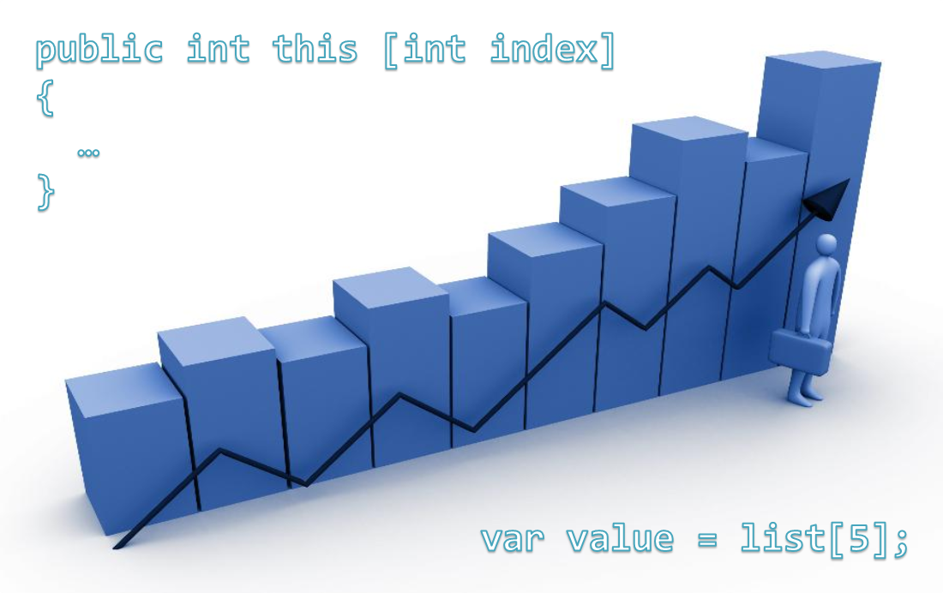
Indexers
Live Demo

Slide 42

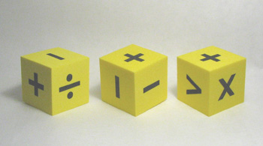
Operators Overloading

Slide 43
Overloading Operators
In C# some operators can be overloaded (redefined) by developers
The priority of operators can not be changed
Not all operators can be overloaded
Overloading an operator in C#
Looks like a static method with 2 operands:
public static Matrix operator *(Matrix m1, Matrix m2)
{
return new m1.Multiply(m2);
}

Slide 44
Overloading Operators (2)
Overloading is allowed on:
Unary operators
Binary operators
Operators for type conversion
Implicit type conversion
Explicit type conversion (type)
+, -, !, ~, ++, --, true and false
+, -, *, /, %, &, |, ^, <<, >>, ==, !=, >, <, >= and <=

Slide 45
Overloading Operators – Example
public static Fraction operator -(Fraction f1,Fraction f2)
{
long num = f1.numerator * f2.denominator -
f2.numerator * f1.denominator;
long denom = f1.denominator * f2.denominator;
return new Fraction(num, denom);
}
public static Fraction operator *(Fraction f1,Fraction f2)
{
long num = f1.numerator * f2.numerator;
long denom = f1.denominator * f2.denominator;
return new Fraction(num, denom);
}
(the example continues)

Slide 46
Overloading Operators – Example (2)
// Unary minus operator
public static Fraction operator -(Fraction fraction)
{
long num = -fraction.numerator;
long denom = fraction.denominator;
return new Fraction(num, denom);
}
// Operator ++ (the same for prefix and postfix form)
public static Fraction operator ++(Fraction fraction)
{
long num = fraction.numerator + fraction.denominator;
long denom = Frac.denominator;
return new Fraction(num, denom);
}

Slide 47

Overloading Operators
Live Demo

Slide 48

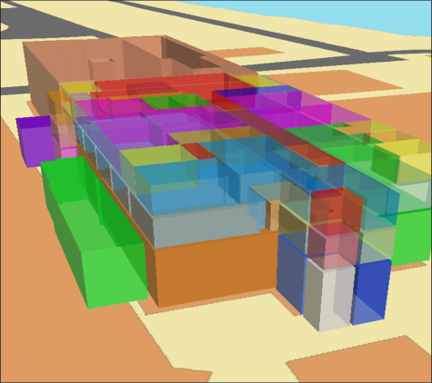
Attributes
Applying Attributes to Code Elements

Slide 49
What are Attributes?
.NET attributes are:
Declarative tags for attaching descriptive information in the declarations in the code
Saved in the assembly at compile time
Objects derived from System.Attribute
Can be accessed at runtime (through reflection) and manipulated by many tools
Developers can define custom attributes

Slide 50
Applying Attributes – Example
Attribute's name is surrounded by square brackets []
Placed before their target declaration
[Flags] attribute indicates that the enum type can be treated like a set of bit flags
[Flags] // System.FlagsAttribute
public enum FileAccess
{
Read = 1,
Write = 2,
ReadWrite = Read | Write
}

Slide 51
Attributes with Parameters (2)
Attributes can accept parameters for their constructors and public properties
The [DllImport] attribute refers to:
System.Runtime.InteropServices. DllImportAttribute
"user32.dll" is passed to the constructor
"MessageBox" value is assigned to EntryPoint
[DllImport("user32.dll", EntryPoint="MessageBox")]
public static extern int ShowMessageBox(int hWnd,
string text, string caption, int type);
…
ShowMessageBox(0, "Some text", "Some caption", 0);

Slide 52
Set a Target to an Attribute
Attributes can specify its target declaration:
See the Properties/AssemblyInfo.cs file
// target "assembly"
[assembly: AssemblyTitle("Attributes Demo")]
[assembly: AssemblyCompany("DemoSoft")]
[assembly: AssemblyProduct("Entreprise Demo Suite")]
[assembly: AssemblyVersion("2.0.1.37")]
[Serializable] // [type: Serializable]
class TestClass
{
[NonSerialized] // [field: NonSerialized]
private int status;
}

Slide 53

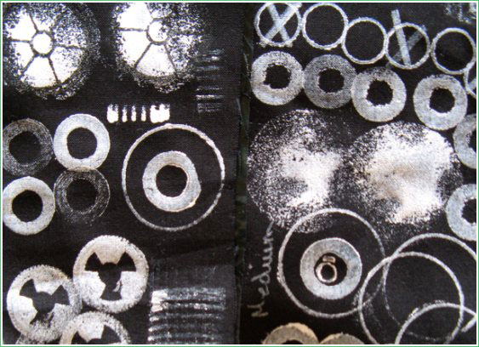

Using Attributes
Live Demo

Slide 54
Custom Attributes
.NET developers can define their own custom attributes
Must inherit from System.Attribute class
Their names must end with 'Attribute'
Possible targets must be defined via [AttributeUsage]
Can define constructors with parameters
Can define public fields and properties

Slide 55
Custom Attributes – Example
[AttributeUsage(AttributeTargets.Struct |
AttributeTargets.Class | AttributeTargets.Interface,
AllowMultiple = true)]
public class AuthorAttribute : System.Attribute
{
public string Name { get; private set; }
public AuthorAttribute(string name)
{
this.Name = name;
}
}
// Example continues

Slide 56
Custom Attributes – Example (2)
[Author("Svetlin Nakov")]
[Author("Nikolay Kostov")]
class CustomAttributesDemo
{
static void Main(string[] args)
{
Type type = typeof(CustomAttributesDemo);
object[] allAttributes =
type.GetCustomAttributes(false);
foreach (AuthorAttribute attr in allAttributes)
{
Console.WriteLine(
"This class is written by {0}. ", attr.Name);
}
}
}

Slide 57

Defining, Applying and Retrieving Custom Attributes
Live Demo

Slide 58
Summary
Classes define specific structure for objects
Objects are particular instances of a class
Constructors are invoked when creating new class instances
Properties expose the class data in safe, controlled way
Static members are shared between all instances
Instance members are per object
Structures are "value-type" classes
Generics are parameterized classes

Slide 59



Defining Classes – Part II
Questions?
http://academy.telerik.com

Slide 60
Exercises
Create a structure Point3D to hold a 3D-coordinate {X, Y, Z} in the Euclidian 3D space. Implement the ToString() to enable printing a 3D point.
Add a private static read-only field to hold the start of the coordinate system – the point O{0, 0, 0}. Add a static property to return the point O.
Write a static class with a static method to calculate the distance between two points in the 3D space.
Create a class Path to hold a sequence of points in the 3D space. Create a static class PathStorage with static methods to save and load paths from a text file. Use a file format of your choice.

Slide 61
Exercises (2)
Write a generic class GenericList<T> that keeps a list of elements of some parametric type T. Keep the elements of the list in an array with fixed capacity which is given as parameter in the class constructor. Implement methods for adding element, accessing element by index, removing element by index, inserting element at given position, clearing the list, finding element by its value and ToString(). Check all input parameters to avoid accessing elements at invalid positions.
Implement auto-grow functionality: when the internal array is full, create a new array of double size and move all elements to it.

Slide 62
Exercises (3)
Create generic methods Min<T>() and Max<T>() for finding the minimal and maximal element in the GenericList<T>. You may need to add a generic constraints for the type T.
Define a class Matrix<T> to hold a matrix of numbers (e.g. integers, floats, decimals).
Implement an indexer this[row, col] to access the inner matrix cells.
Implement the operators + and - (addition and subtraction of matrices of the same size) and * for matrix multiplication. Throw an exception when the operation cannot be performed. Implement the true operator (check for non-zero elements).

Slide 63
Exercises (4)
Create a [Version] attribute that can be applied to structures, classes, interfaces, enumerations and methods and holds a version in the format major.minor (e.g. 2.11). Apply the version attribute to a sample class and display its version at runtime.

Slide 64




Free Trainings @ Telerik Academy
C# Programming @ Telerik Academy
csharpfundamentals.telerik.com
Telerik Software Academy
academy.telerik.com
Telerik Academy @ Facebook
facebook.com/TelerikAcademy
Telerik Software Academy Forums
forums.academy.telerik.com

